Slide 1
TRANSMISSION IMPAIRMENT
Signals travel through transmission media, which are not perfect.
The imperfection causes signal impairment.
This means that the signal at the beginning of the medium is not the same as the signal at the end of the medium.
What is sent is not what is received.
Three causes of impairment are attenuation, distortion, and noise.

Slide 2
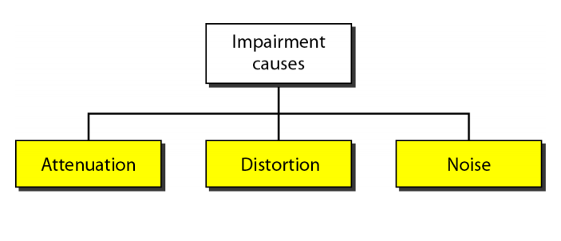

Slide 3
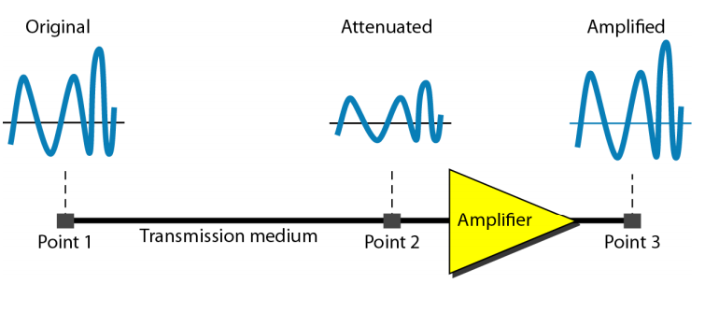
Attenuation

Slide 4
.
Attenuation(dB) = 10log10(P2/P1)
P1 is the power at sending end and
P2 is the power at receiving end
Attenuation(dB) = 20log10(V2/V1)
V1 is the voltage at sending end and
V2 is the voltage at receiving end

Slide 5
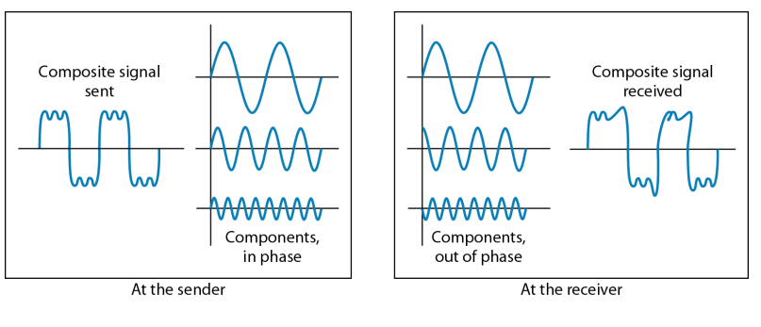
Distortion

Slide 6
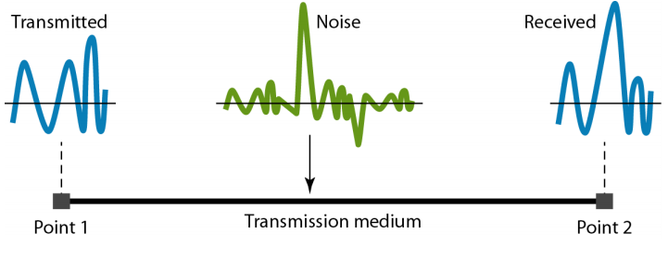
Noise

Slide 7
Nyquist Bandwidth
If rate of signal transmission is 2B then signal with frequencies no greater than B is sufficient to carry signal rate
Given bandwidth B, highest signal rate is 2B
Given binary signal, data rate supported by B Hz is 2B bps
Can be increased by using M signal levels
C= 2B log₂M

Slide 8
Shannon Capacity Formula
Consider data rate, noise and error rate
Faster data rate shortens each bit so burst of noise affects more bits
At given noise level, high data rate means higher error rate
Signal to noise ratio (in decibels)
SNR_{db}⁼10 log₁₀ (signal/noise)
Capacity C=B log₂(1+SNR)
This is error free capacity

Slide 9
Performance
One important issue in networking is the performance of the network—how good is it? quality of service, an overall measurement of network performance.
Bandwidth - capacity of the system
Throughput - no. of bits that can be pushed through
Latency (Delay) - delay incurred by a bit from start to finish
Bandwidth -Delay Product

Slide 10
In networking, the term bandwidth is used in two contexts.
The first, bandwidth in hertz, refers to the range of frequencies in a composite signal or the range of frequencies that a channel can pass.
The second, bandwidth in bits per second, refers to the speed of bit transmission in a channel or link. Often referred to as Capacity.
Propagation speed - speed at which a bit travels though the medium from source to destination.
Transmission speed - the speed at which all the bits in a message arrive at the destination. (difference in arrival time of first and last bit)

Slide 11
Propagation Delay = Distance/Propagation speed
Transmission Delay = Message size/bandwidth bps
Latency = Propagation delay + Transmission delay + Queueing time + Processing time

